Slide 1
MGS 723: Geodynamics
Class 16: Finite Differences IV
(Advection)
Content mainly sourced from: i) Becker and Kaus, Numerical Geodynamics, ii) Spiegelman, Myths and Methods in Modeling.

Slide 2
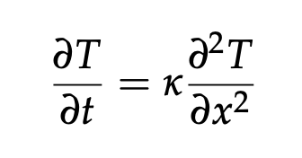
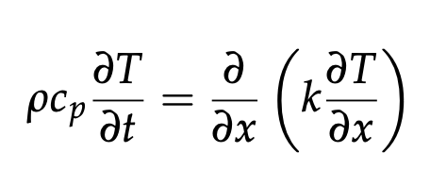
So far, we’ve focused on the heat conduction equation:
(1-D)
or

Slide 3
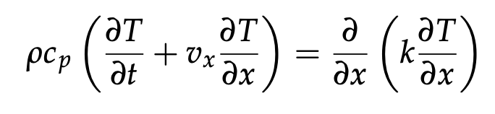
So far, we’ve focused on the heat conduction equation:
(1-D)
or
If we take fluid motion into account, this becomes the diffusion-advection equation:
(1-D)

Slide 4
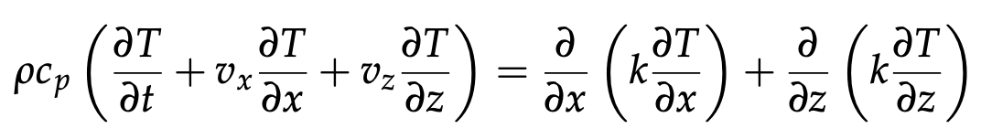
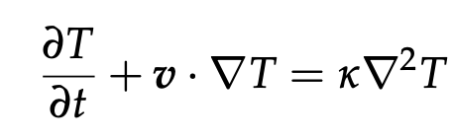
So far, we’ve focused on the heat conduction equation:
(1-D)
or
If we take fluid motion into account, this becomes the diffusion-advection equation:
(1-D)
(2-D)
(generalized)

Slide 5
So far, we’ve focused on the heat conduction equation:
(1-D)
or
If we take fluid motion into account, this becomes the diffusion-advection equation:
(1-D)
(2-D)
(generalized)
How to deal with this advection (transport) term?
Why is it important in Geodynamics?

Slide 6
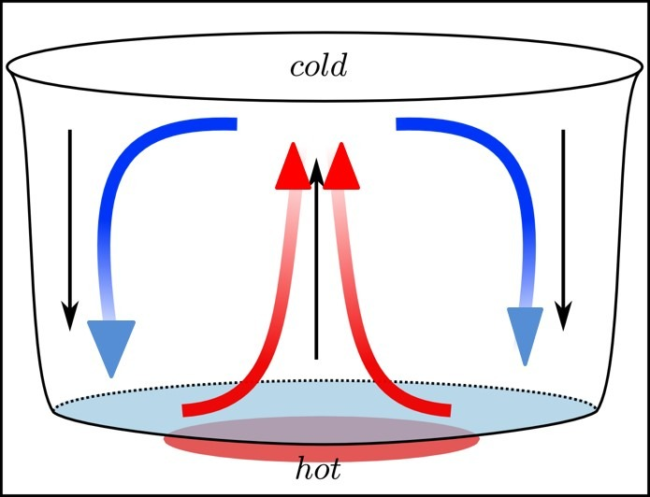
Need to solve for both components of thermal evolution in order to model convection:
= Transfer of heat from one place to another due to the movement of fluid. Involves both conduction (no fluid motion) and advection (fluid motion)

Slide 7
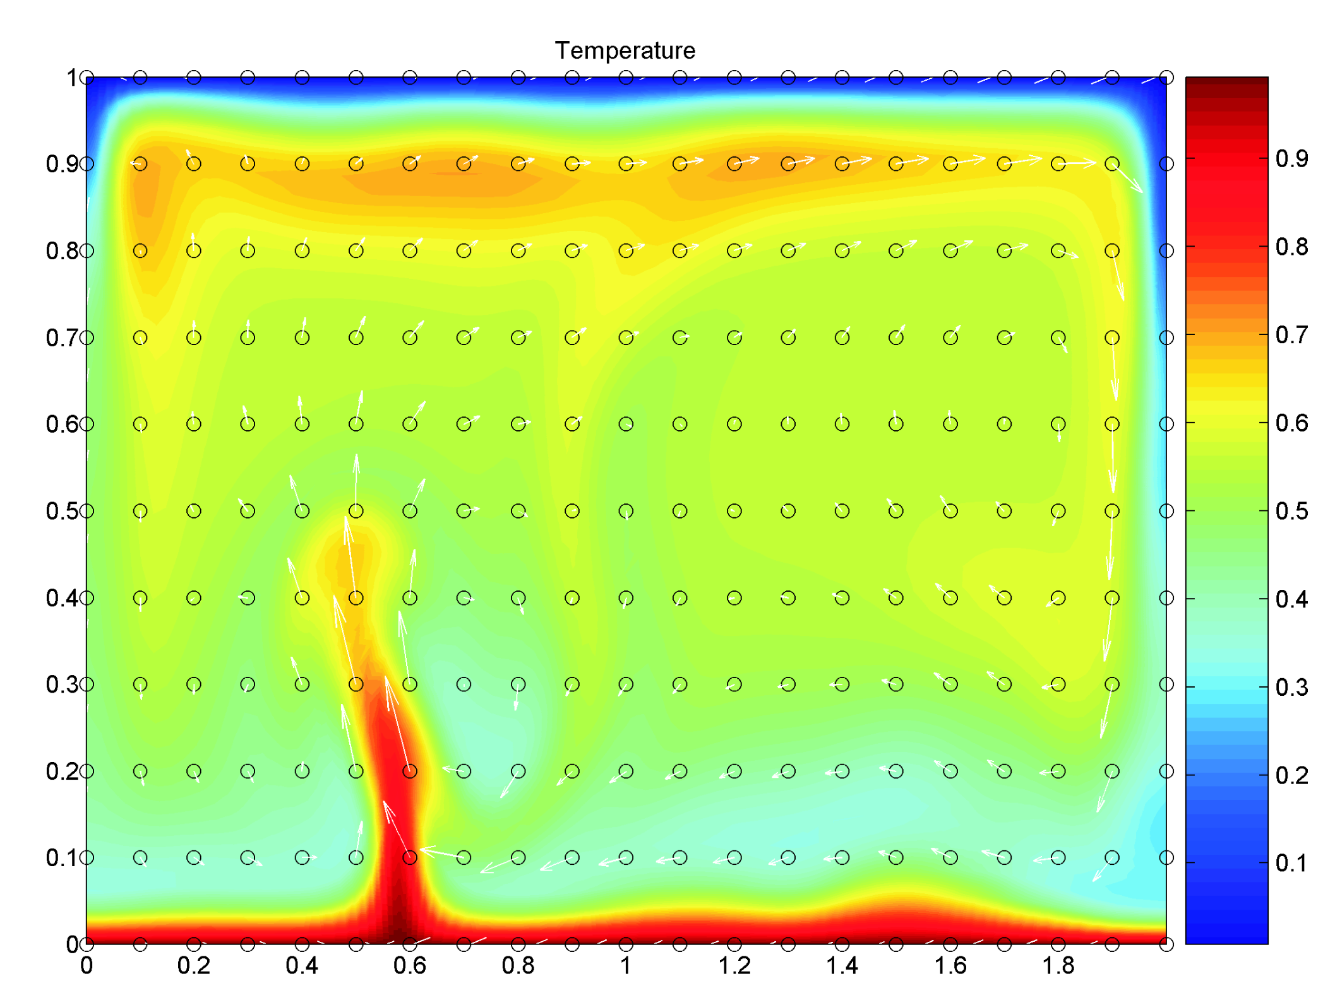
Need to solve for both components of thermal evolution in order to model convection:
e.g.,
Becker and Kaus

Slide 8
Need to solve for both components of thermal evolution in order to model convection:
e.g.,
Becker and Kaus
Also need to solve a separate set of equations to get v. We will get to that next but, for now, will prescribe v.

Slide 9
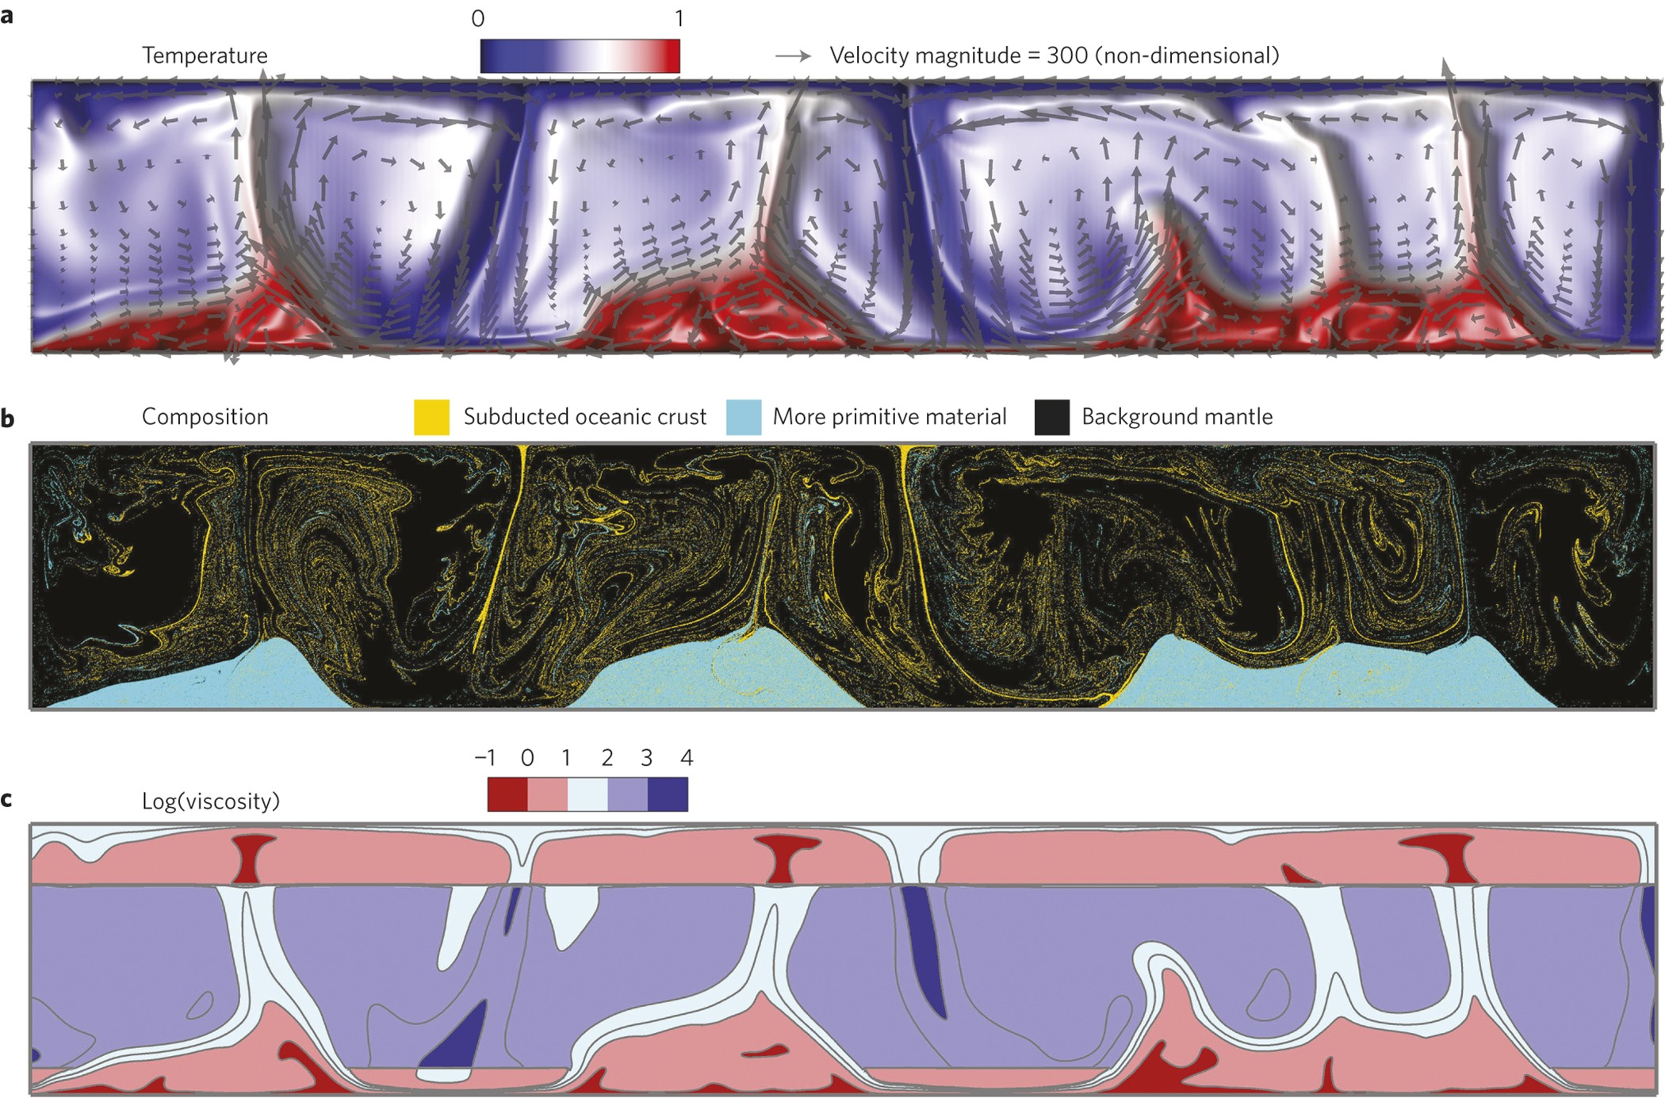
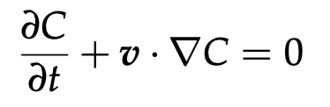
Note: we often also want to advect different materials / compositions in our model (i.e., not just T)
Li et al., 2014, Nat. Geosc.
C = some compositional phase

Slide 10
So far, we’ve focused on the heat conduction equation:
(1-D)
or
If we take fluid motion into account, this becomes the diffusion-advection equation:
(1-D)
(2-D)
(generalized)
How to deal with this advection term?

Slide 11
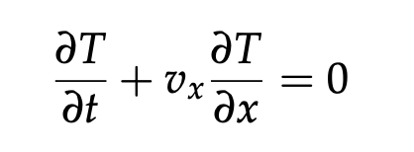
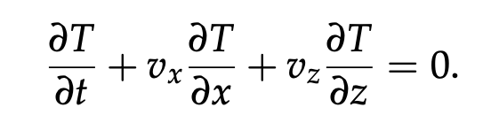
Advection (transport) equations
Let’s begin by considering pure advection (i.e., no diffusion, or k = 0):
(1-D)
(2-D)

Slide 12
Advection (transport) equations
Let’s begin by considering pure advection (i.e., no diffusion, or k = 0):
(1-D)
(2-D)
Despite appearing simple, can be trickier to solve accurately than the diffusion problem.
Particularly if there are large gradients in the quantity that is to be advected.
If not done carefully, can end up with numerical artifacts such as wiggles (oscillations) and numerical diffusion (artificial smoothing of the solution).

Slide 13
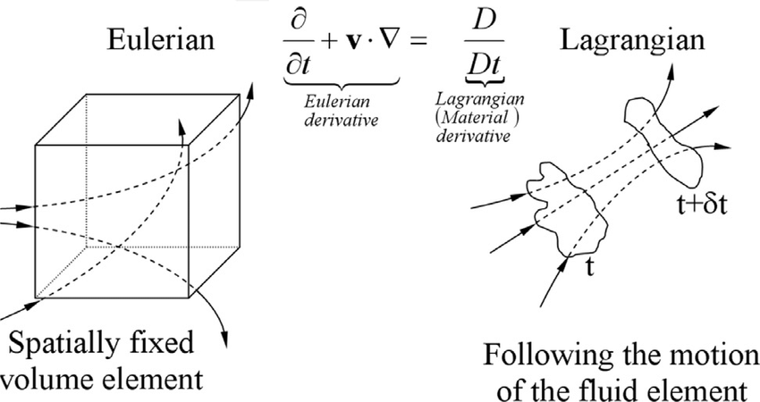
Advection (transport) equations
Let’s begin by considering pure advection (i.e., no diffusion, or k = 0):
(1-D)
(2-D)

Slide 14
Advection (transport) equations
Let’s begin by considering pure advection (i.e., no diffusion, or k = 0):
(1-D)
(2-D)
Can do this using Eulerian (fixed grid) or Lagrangian (track particles) methods. We will begin with Eulerian…

Slide 15
Advection (transport) equations
Let’s begin by considering pure advection (i.e., no diffusion, or k = 0):
(1-D)
(2-D)
Some Eulerian advection schemes we will cover: (Also Ex. 4 )
FTCS scheme (Forward Time, Centered-difference Scheme)
Lax method
Streamline upwind scheme
Staggered leapfrog

Slide 16
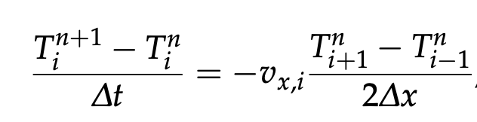
1 – FTCS Scheme
(1-D)

Slide 17
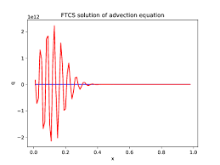
1 – FTCS Scheme
(1-D)
This scheme does not work well!
FTCS method is unconditionally unstable
Can be shown to the be the case using a von Neumann stability analysis (see, e.g.,
Section 5.4 in Spiegelman,
2004, notes)

Slide 18
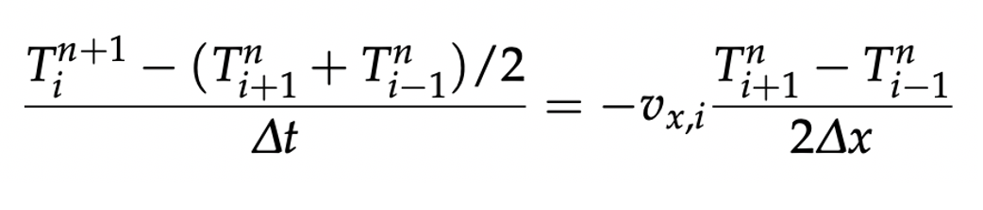
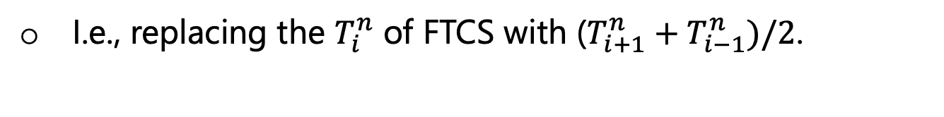
2 – Lax Method
(1-D)
I.e., replacing the $T_{i}^{n}$ of FTCS with ($T_{i+1}^{n}+T_{i−1}^{n})/2$.

Slide 19
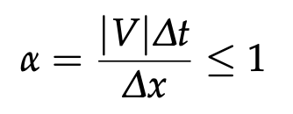
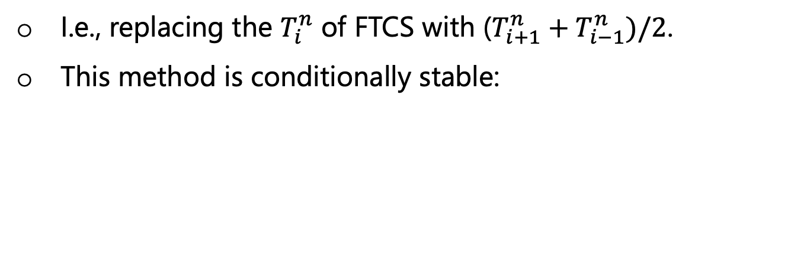
2 – Lax Method
(1-D)
I.e., replacing the $T_{i}^{n}$ of FTCS with ($T_{i+1}^{n}+T_{i−1}^{n})/2$.
This method is conditionally stable:
Stability requirement: the Courant Criterion:

Slide 20
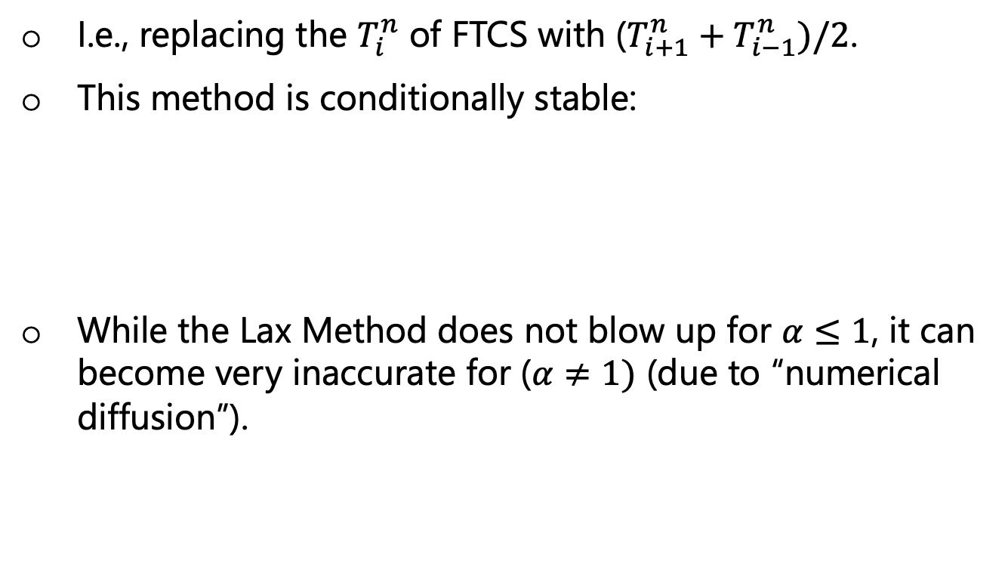
2 – Lax Method
(1-D)
I.e., replacing the $T_{i}^{n}$ of FTCS with ($T_{i+1}^{n}+T_{i−1}^{n})/2$.
This method is conditionally stable:
While the Lax Method does not blow up for $α≤1$, it can become very inaccurate for ($α≠1)$ (due to “numerical diffusion”).
Stability requirement: the Courant Criterion:

Slide 21
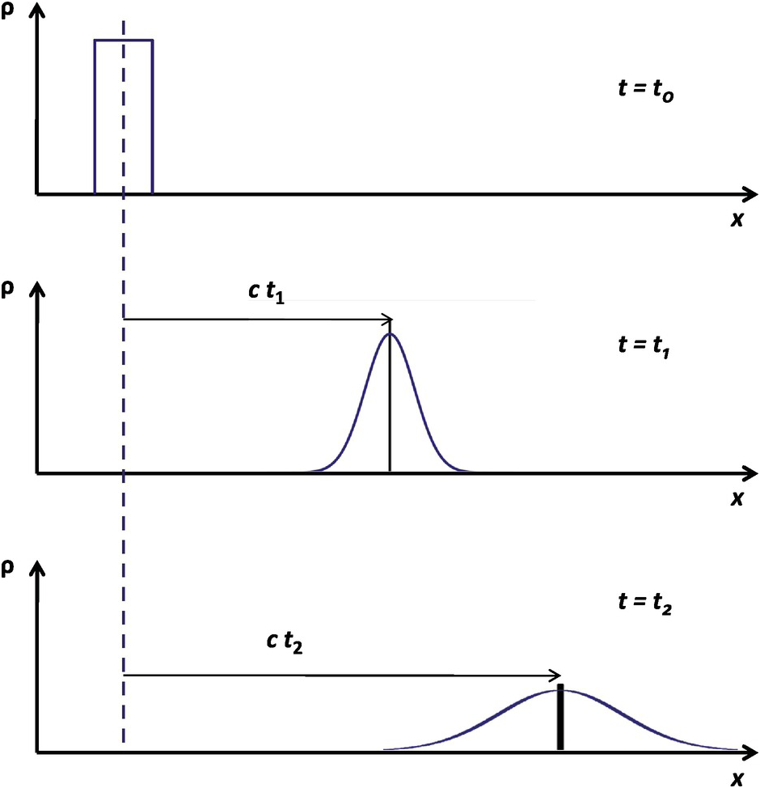
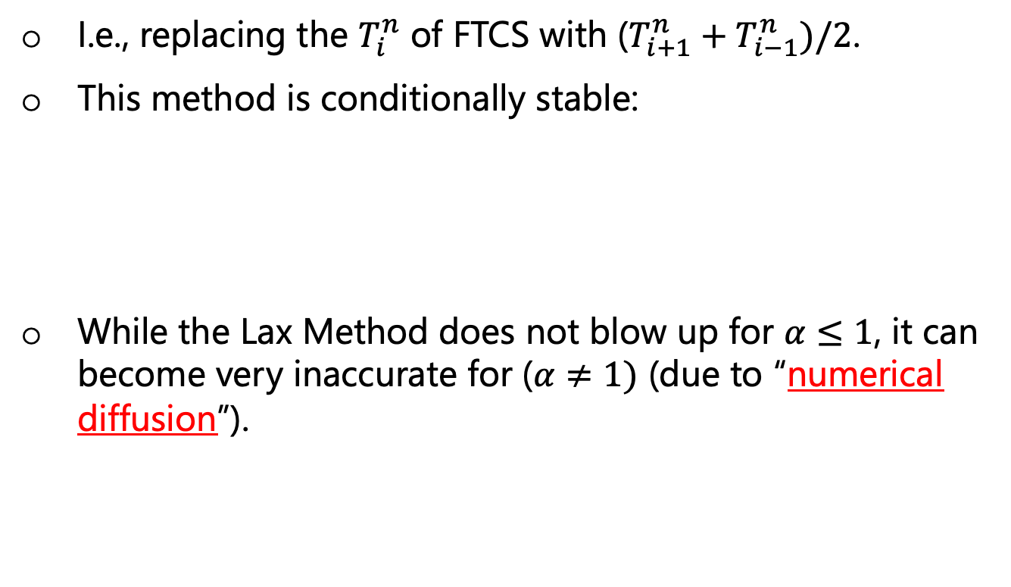
2 – Lax Method
(1-D)
I.e., replacing the $T_{i}^{n}$ of FTCS with ($T_{i+1}^{n}+T_{i−1}^{n})/2$.
This method is conditionally stable:
While the Lax Method does not blow up for $α≤1$, it can become very inaccurate for ($α≠1)$ (due to “numerical diffusion”).
Stability requirement: the Courant Criterion:
i.e., artificial smoothing of the solution

Slide 22
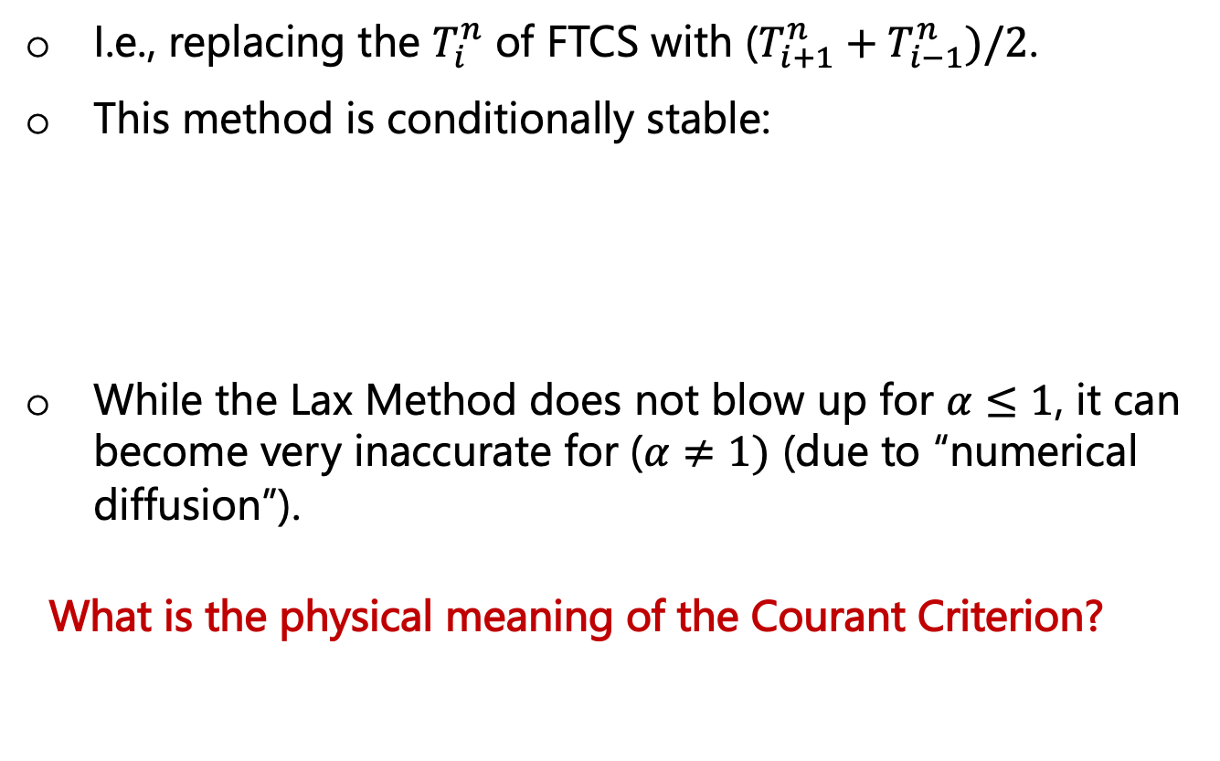
2 – Lax Method
(1-D)
I.e., replacing the $T_{i}^{n}$ of FTCS with ($T_{i+1}^{n}+T_{i−1}^{n})/2$.
This method is conditionally stable:
While the Lax Method does not blow up for $α≤1$, it can become very inaccurate for ($α≠1)$ (due to “numerical diffusion”).
What is the physical meaning of the Courant Criterion?
Stability requirement: the Courant Criterion:

Slide 23
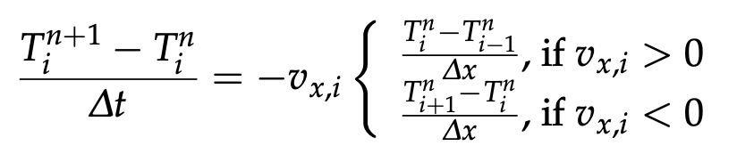
3 – Streamline Upwind Scheme
(1-D)
I.e., replacing the central spatial derivatives of the FTCS with forward/backwards derivatives depending on the direction of the flow.

Slide 24
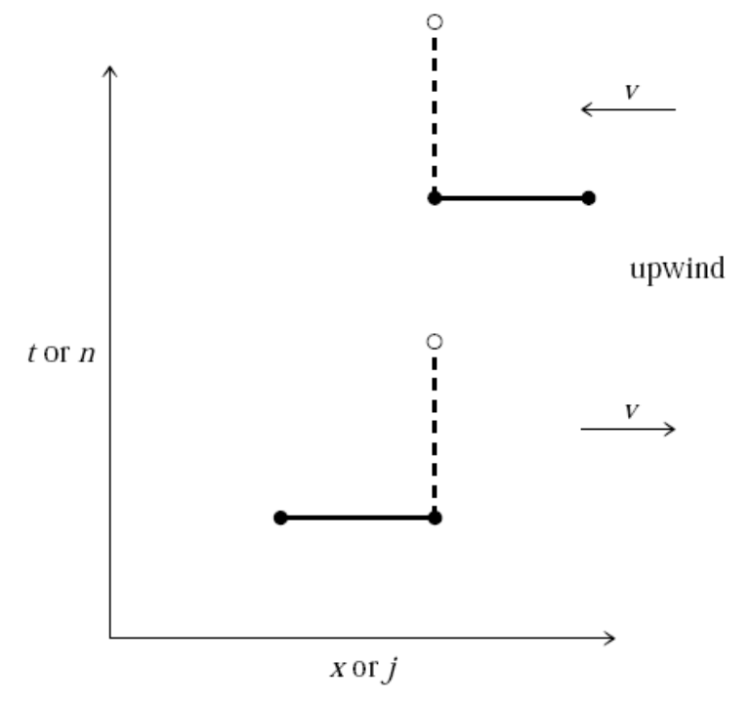
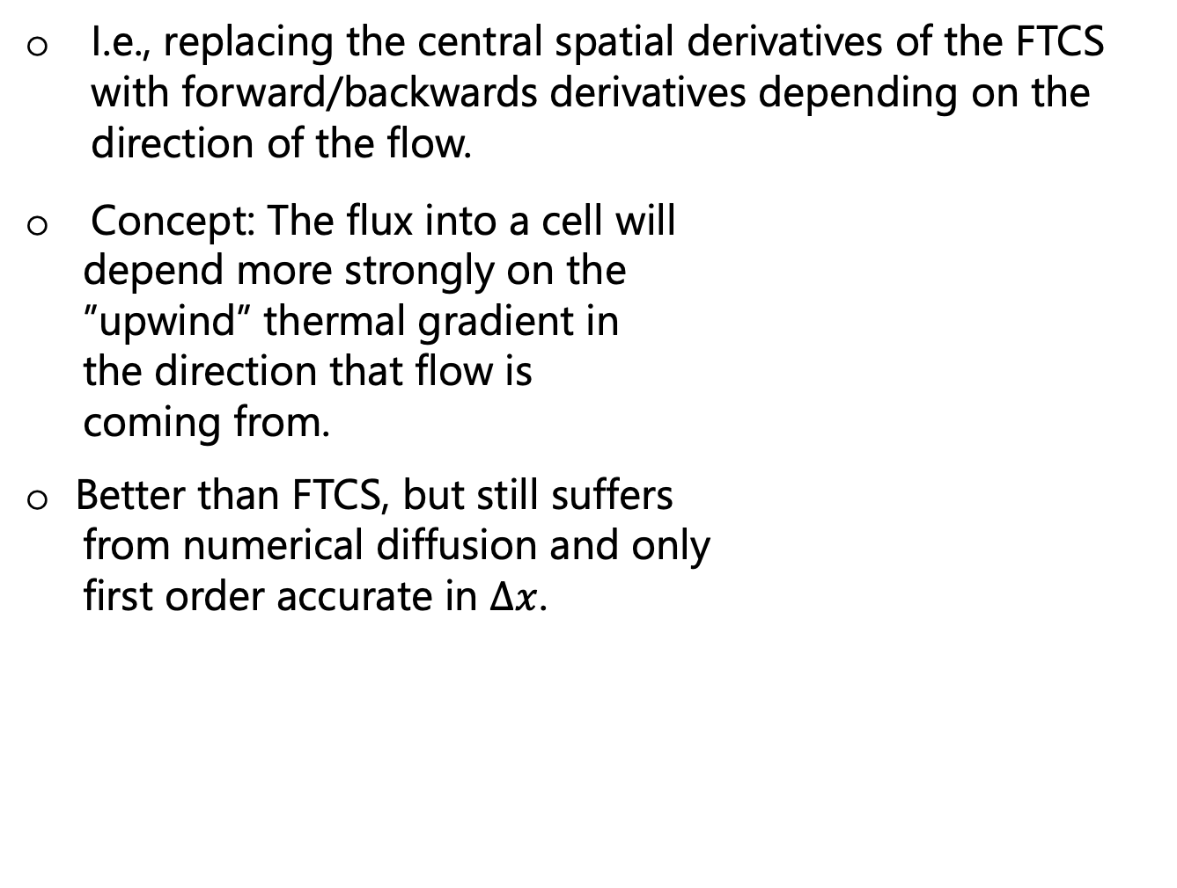
3 – Streamline Upwind Scheme
(1-D)
I.e., replacing the central spatial derivatives of the FTCS with forward/backwards derivatives depending on the direction of the flow.
Concept: The flux into a cell will
depend more strongly on the
”upwind” thermal gradient in
the direction that flow is
coming from.
Better than FTCS, but still suffers
from numerical diffusion and only
first order accurate in $∆x$.

Slide 25
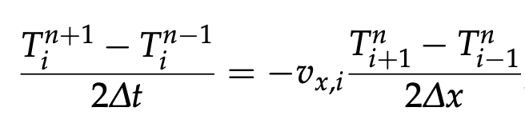
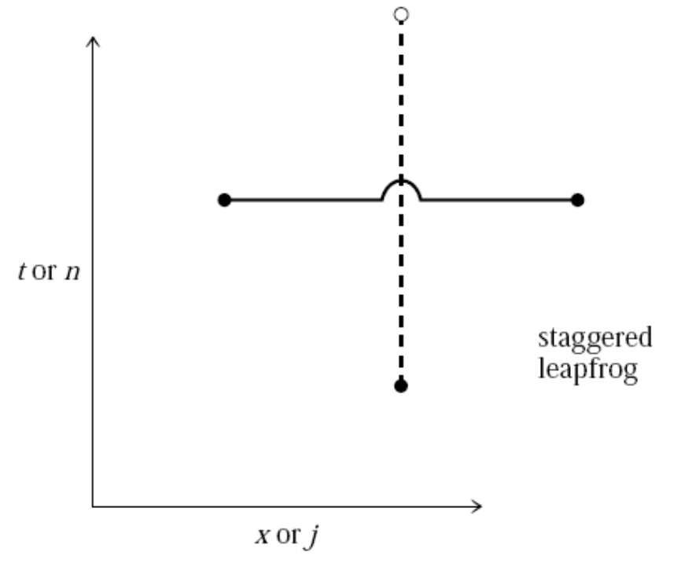
4 – Staggered Leapfrog
(1-D)

Slide 26
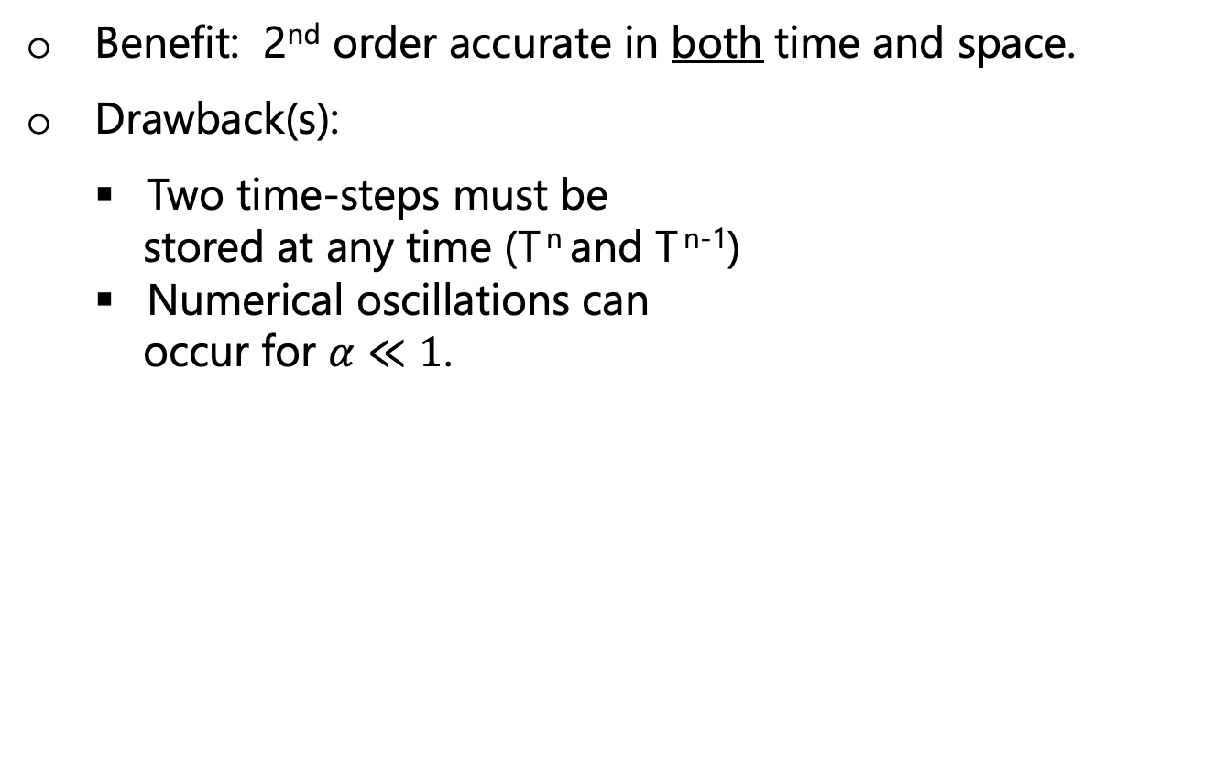
4 – Staggered Leapfrog
(1-D)
Benefit: 2nd order accurate in both time and space.
Drawback(s):
Two time-steps must be
stored at any time (T ^{n} and T ^{n-1})
Numerical oscillations can
occur for $α≪1$.

Slide 27
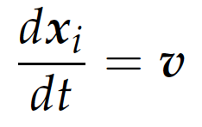
An alternative for advecting things: Lagrangian Methods
Relates to advecting quantities by tracking particle locations x_{i} (as they move around in the flow, v):
x_{i} is the location of the i^{th} tracer particle moving through the fluid at v.

Slide 28
Lagrangian Methods
Relates to advecting quantities by tracking particle locations x_{i} (as they move around in the flow, v):
x_{i} is the location of the i^{th} tracer/particle/marker moving through the fluid at v.

Slide 29
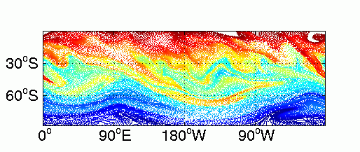
Lagrangian Methods
Relates to advecting quantities by tracking particle locations x_{i} (as they move around in the flow, v):
This is the one of the main methods used to track non- diffusive properties (e.g., chemical composition) within geodynamic models.
x_{i} is the location of the i^{th} tracer/particle/marker moving through the fluid at v.

Slide 30
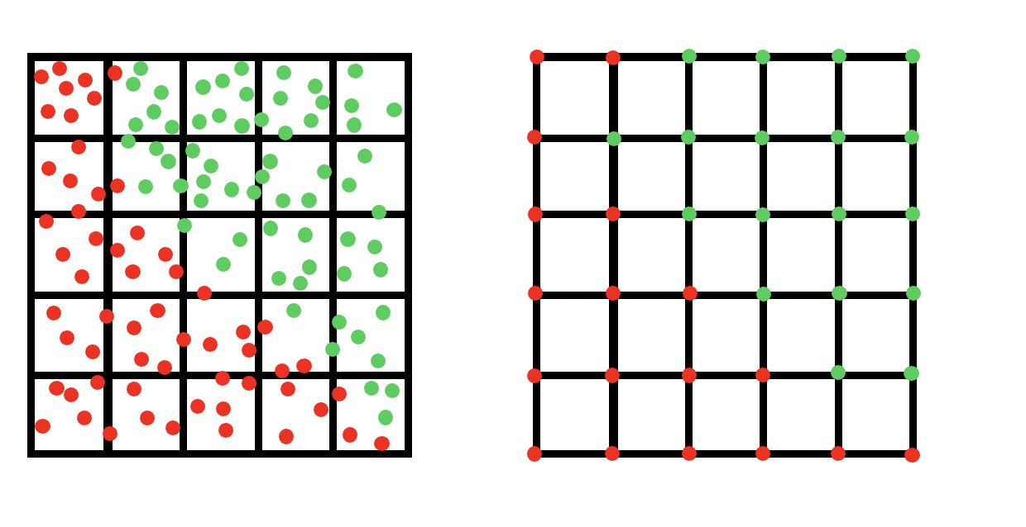
Lagrangian Methods
Relates to advecting quantities by tracking particle locations x_{i} (as they move around in the flow, v):
This is the one of the main methods used to track non- diffusive properties (e.g., chemical composition) within geodynamic models.
x_{i} is the location of the i^{th} tracer/particle/marker moving through the fluid at v.
The properties of the Lagrangian markers can then be interpolated onto a fixed Eulerian grid: i.e., Marker-in-cell

Slide 31
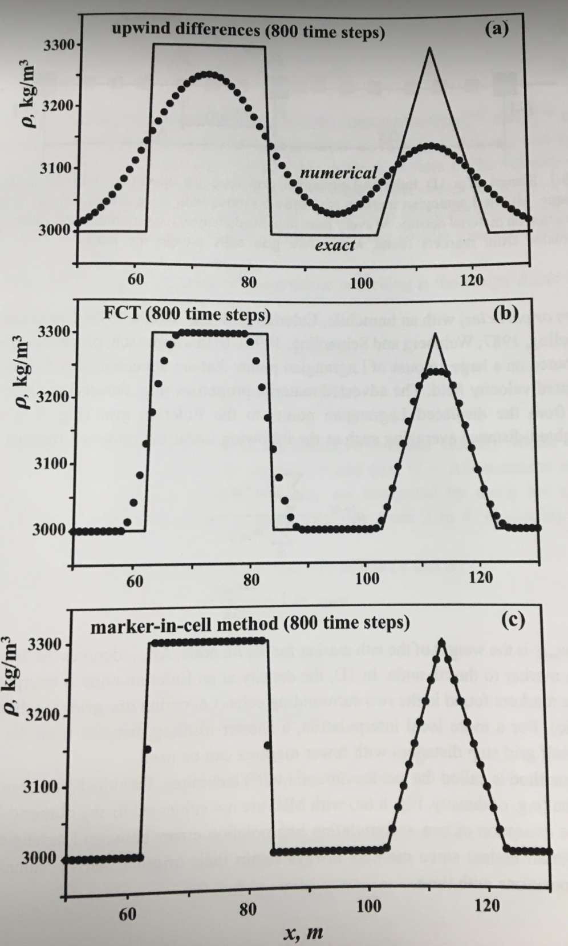
Using (Lagrangian) markers within a (Eulerian) grid can vastly minimize numerical diffusion
(As is relevant for non-diffusive properties)
Gerya, 2nd ed., 2019

Slide 32
The Semi-Lagrangian Method
We can apply this Lagrangian method of thinking (i.e., moving particles) without explicitly defining particles in the Semi-Lagrangian method.

Slide 33
The Semi-Lagrangian Method
We can apply this Lagrangian method of thinking (i.e., moving particles) without explicitly defining particles in the Semi-Lagrangian method.
Better than most purely Eulerian methods for advection (e.g., FTCS, Lax, …) because:
Stable
Small numerical diffusion
Not limited by Courant Criterion

Slide 34
The Semi-Lagrangian Method
We can apply this Lagrangian method of thinking (i.e., moving particles) without explicitly defining particles in the Semi-Lagrangian method.
Better than most purely Eulerian methods for advection (e.g., FTCS, Lax, …) because:
Stable
Small numerical diffusion
Not limited by Courant Criterion
This is what we will use for advection in our 2-D models

Slide 35
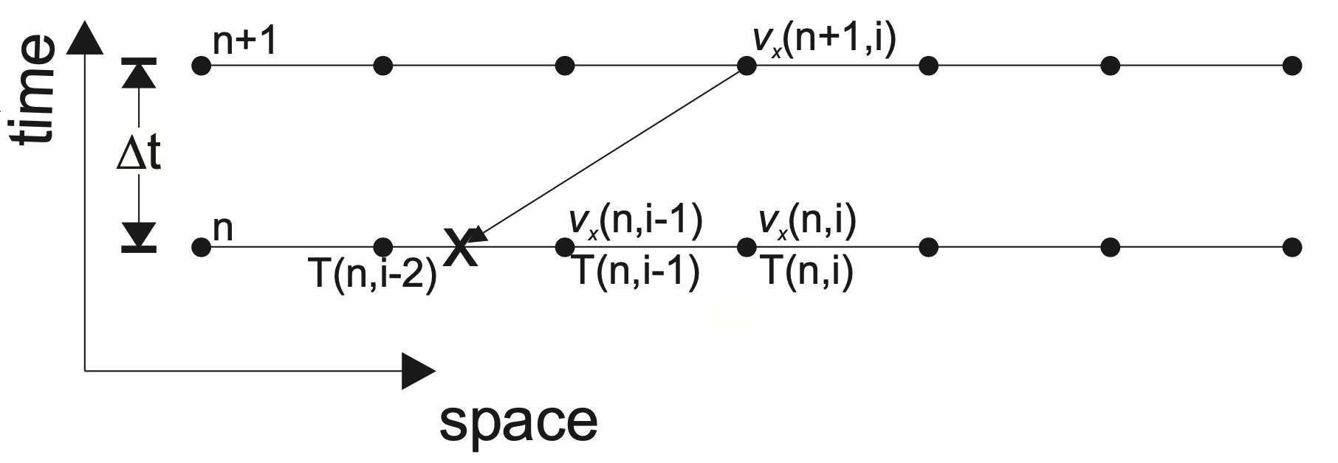
Semi-Lagrangian Methods: How to apply to advection of T?
A basic algorithm:
Becker and Kaus

Slide 36
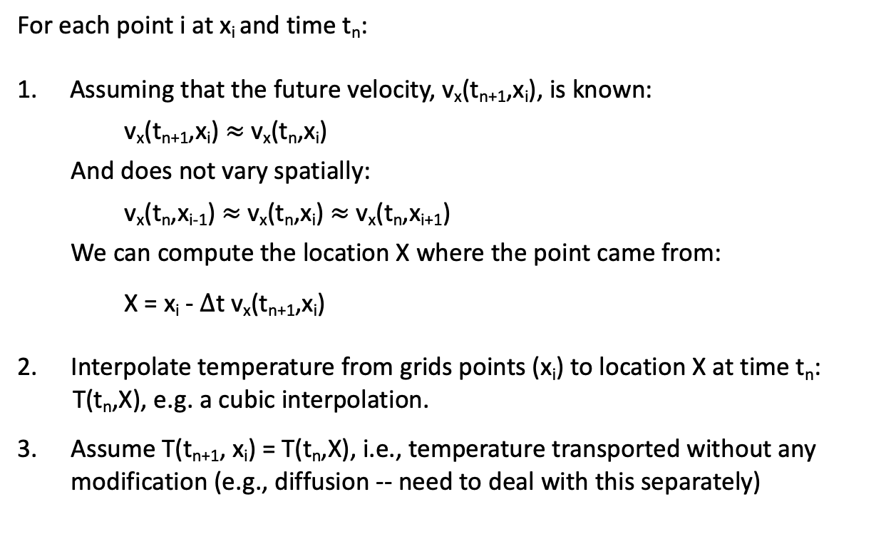
Semi-Lagrangian Methods: How to apply to advection of T?
A basic algorithm:
Becker and Kaus
For each point i at x_{i} and time t_{n}:
Assuming that the future velocity, v_{x}(t_{n+1},x_{i}), is known:
v_{x}(t_{n+1},x_{i}) $≈$ v_{x}(t_{n},x_{i})
And does not vary spatially:
v_{x}(t_{n},x_{i-1}) $≈$ v_{x}(t_{n},x_{i}) $≈$ v_{x}(t_{n},x_{i+1})
We can compute the location X where the point came from:
X = x_{i} - $∆$t v_{x}(t_{n+1},x_{i})
2. Interpolate temperature from grids points (x_{i}) to location X at time t_{n}:
T(t_{n},X), e.g. a cubic interpolation.
3. Assume T(t_{n+1}, x_{i}) = T(t_{n},X), i.e., temperature transported without any
modification (e.g., diffusion -- need to deal with this separately)
Becker and Kaus

Slide 37
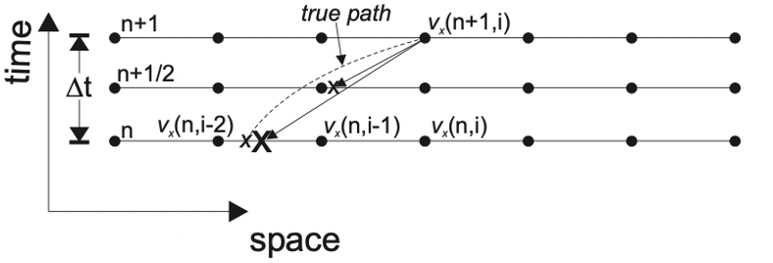
Semi-Lagrangian Methods: How to apply to advection of T?
An improved algorithm:
(That doesn’t assume velocity constant in
space and time)
Becker and Kaus

Slide 38
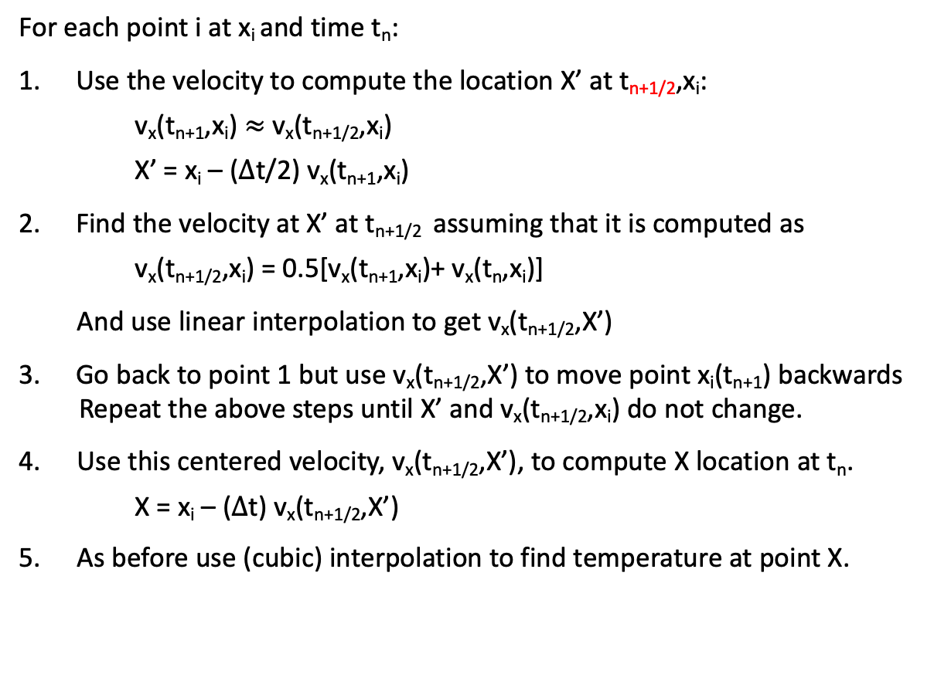
Semi-Lagrangian Methods: How to apply to advection of T?
An improved algorithm:
(That doesn’t assume velocity constant in
space and time)
Becker and Kaus
For each point i at x_{i} and time t_{n}:
Use the velocity to compute the location X’ at t_{n+1/2},x_{i}:
v_{x}(t_{n+1},x_{i}) $≈$ v_{x}(t_{n+1/2},x_{i})
X’ = x_{i} – ($∆$t/2) v_{x}(t_{n+1},x_{i})
Find the velocity at X’ at t_{n+1/2} assuming that it is computed as
v_{x}(t_{n+1/2},x_{i}) = 0.5[v_{x}(t_{n+1},x_{i})+ v_{x}(t_{n},x_{i})]
And use linear interpolation to get v_{x}(t_{n+1/2},X’)
Go back to point 1 but use v_{x}(t_{n+1/2},X’) to move point x_{i}(t_{n+1}) backwards
Repeat the above steps until X’ and v_{x}(t_{n+1/2},x_{i}) do not change.
4. Use this centered velocity, v_{x}(t_{n+1/2},X’), to compute X location at t_{n}.
X = x_{i} – ($∆$t) v_{x}(t_{n+1/2},X’)
5. As before use (cubic) interpolation to find temperature at point X.
Becker and Kaus

Slide 39
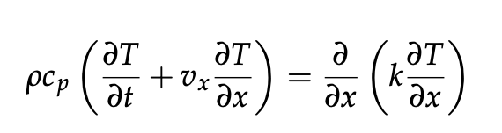
Operator splitting
We often want to solve the advection-diffusion equation in geodynamics:
Advection
Diffusion

Slide 40
Operator splitting
We often want to solve the advection-diffusion equation in geodynamics:
Advection
Diffusion
One common method is operator splitting: i.e., splitting the equation up into two parts:

Slide 41
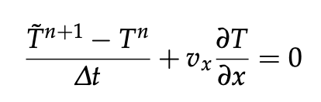
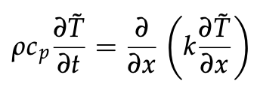
Operator splitting
We often want to solve the advection-diffusion equation in geodynamics:
Advection
Diffusion
One common method is operator splitting: i.e., splitting the equation up into two parts:
First solve the advection equation component (e.g., using a semi-Lagrangian advection scheme)
Then solve the diffusion equation component (e.g., using one of the methods discussed during the last two classes):

Slide 42
Next class: Going back to theory (simple problems in fluid dynamics and convection) before we return to more numerical methods

Slide 43
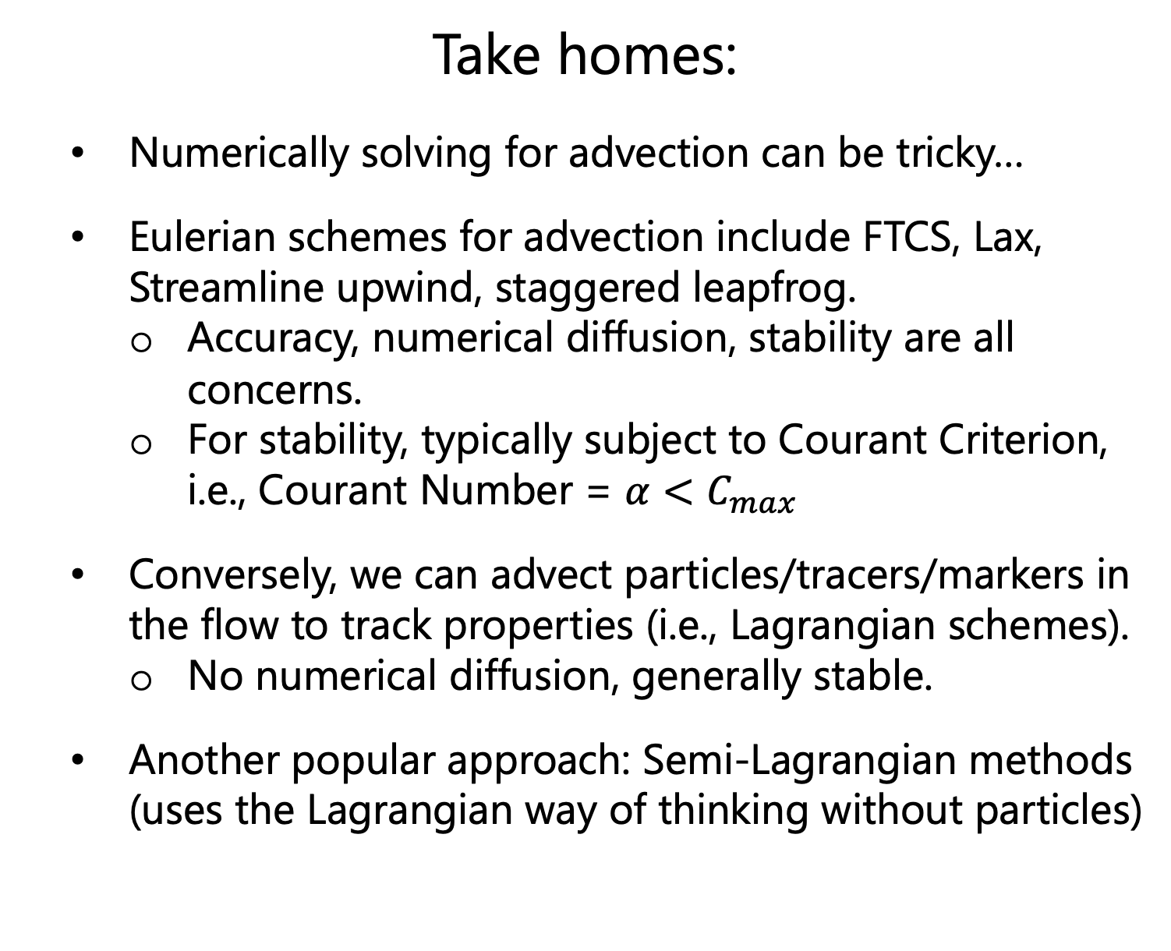
Take homes:
Numerically solving for advection can be tricky…
Eulerian schemes for advection include FTCS, Lax, Streamline upwind, staggered leapfrog.
Accuracy, numerical diffusion, stability are all concerns.
For stability, typically subject to Courant Criterion, i.e., Courant Number = $α<C_{max}$
Conversely, we can advect particles/tracers/markers in the flow to track properties (i.e., Lagrangian schemes).
No numerical diffusion, generally stable.
Another popular approach: Semi-Lagrangian methods (uses the Lagrangian way of thinking without particles)

